Slide 1
CommUnity Technical Presentation
Put content here first, and style later

Slide 2
Not Every Question Matters to Everyone
When is next BHT fire drill?
Would you recommend growing basil in the dorms?
Is there a public piano in KE?
Which kitchen in SE has the best oven?
What is the best study spot in the science building?
Is the Beta washer
fixed yet?

Slide 3
CommUnity is a help forum partitioned by location
Dorms
Academic Buildings
KE Apartments
Which kitchen in SE has the best oven?
What is the best study spot in the science building?
Is there a public piano in KE?
Would you recommend growing basil in the dorms?
Is the Beta washer fixed yet?
When is next BHT fire drill?

Slide 4
Our Vision
With CommUnity, users can reach out to their own communities to ask and answer questions. The app is designed for Calvin communities, but the concept could be expanded.
The app prevents anonymous posts to encourage genuine community.

Slide 5
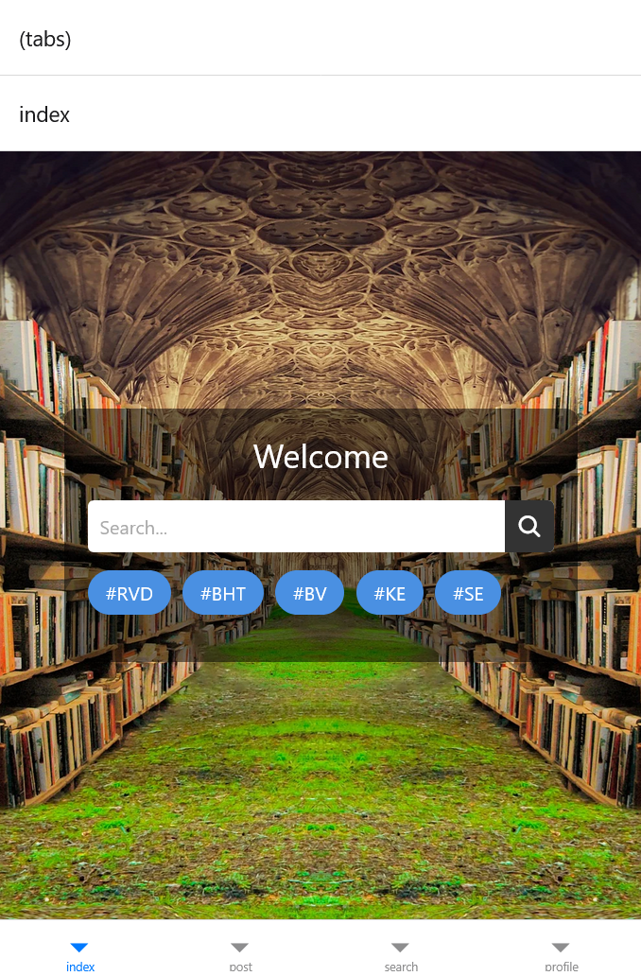
Demonstration Notes
Key functional requirements include:
Users search existing questions
Users ask questions
Users check their own past questions
Users reply to questions
Users log in
Key UI design features include
Search tags
“My posts” under “profile”

Slide 6
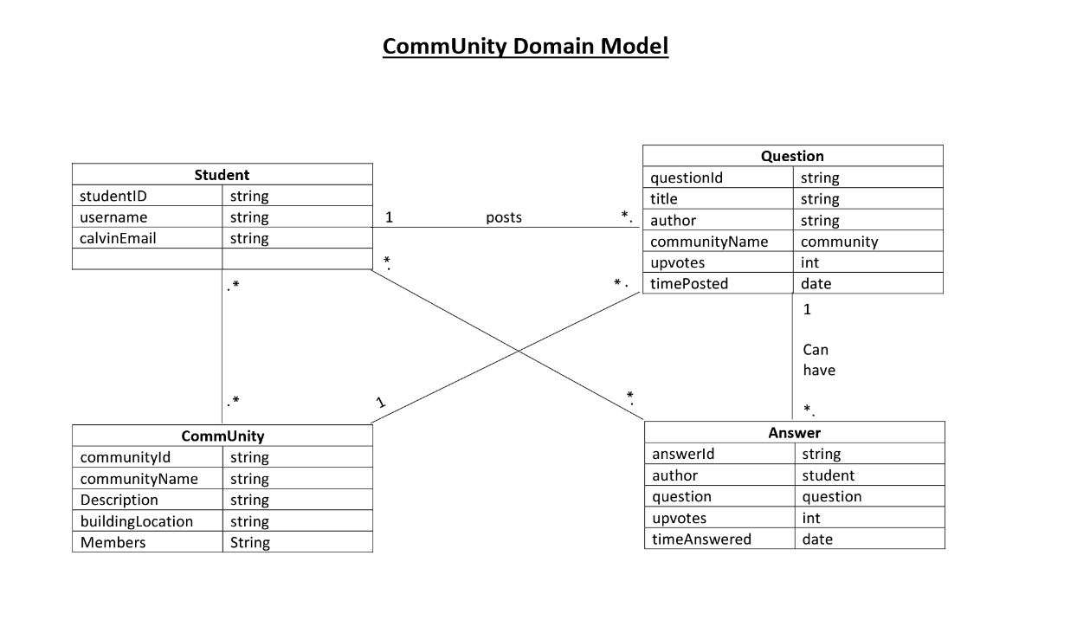
Our Domain Analysis

Slide 7
A Central Design Question: How Much Like Social Media?
Yes:
No:
Likes/upvotes on replies
Searchable posts
Minimal profile info
For the sake of moderators
Endless scrolling feed
Public customizable profile
Anonymous posts
Optional Slide: Gage time

Slide 8
Progress
Done:
Yet To Do:
UI and connections between main pages
Login page that sends data to app
Beginning setup for search
Functionality for posting and sorting posts
Reply page
Integration with data service

Slide 9
Become a Community: Ask us Some Questions!

